Slide 1
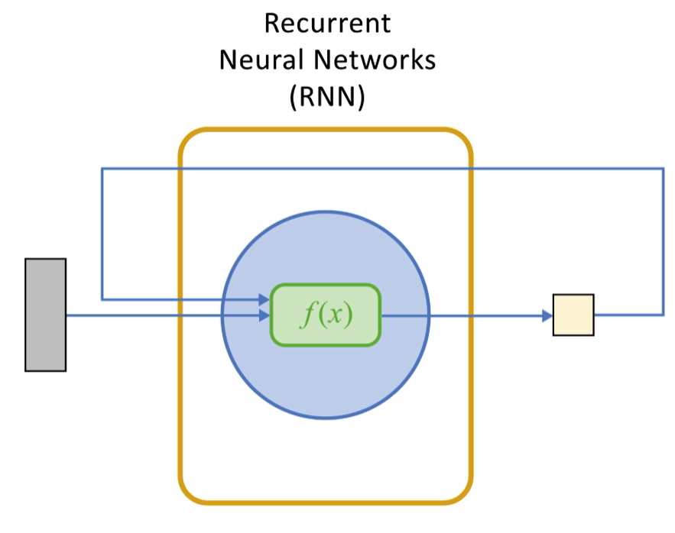



Recurrent Neural Networks
$$h_{t−1}$$
$$x_{t}$$
$$h_{t}$$

Slide 2
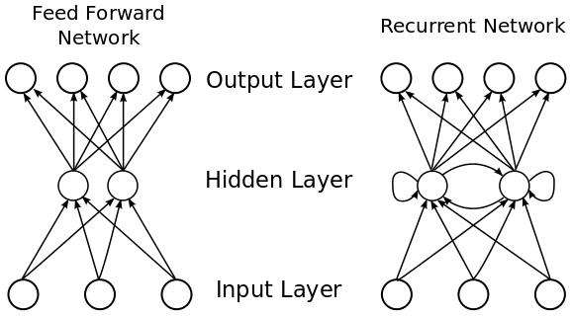
Neural Networks for videos
In a Feed-Forward Network, information flows only in the forward direction, from input layer, through the hidden layers and to the output layer
There are no cycles or loops in the network
Decisions are based on current input
There is no memory about the past
All inputs and outputs are independent of each other
Videos are sequences of images, hence can be seen as sequence data
Input
Output
Hidden Units
Notes:
Feedforward Neural Networks can not handle sequential data They considers only the current input and don’t have a memory about the past.
In Feedforward Neural Networks input instances are independent of each other.
However, in several applications, such as video analysis or speech recognition, the input is a sequence of data (i.e a video is a sequence of images)

Slide 3
Recurrent Neural Networks
Recurrent Neural Networks (RNNs) are a family of networks that work on the principle of saving the output of a layer by feeding it back to the input
Considering the current input and also the previously received inputs, RNNs can handle sequential data
They can memorize previous inputs using an internal memory
Input Patterns
Output Patterns
Internal Representation Units
Notes:
The RNNs are introduced to solve problems involving sequences of data.
They introduce internal loops to feed the output of the network back to the input.
The previous output is used to process the next time step.

Slide 4
Internal view of RNN
RNNs introduce cycles and a notion of time by combining
distributed hidden state that allows them to store information about the past
non-linear dynamics that allows them to update their hidden state in complicated ways
RNNs are the prime candidates for problems involving sequences of data:
Natural language processing
Signal classification
Video analysis
$$h_{t−1}$$
$$x_{t}$$
$$h_{t}$$
Notes:
Natural language processing, signal classification, and video analysis are examples that involve the use of RNN.

Slide 5












Understanding Recurrent Neural Networks
A RNN can be considered as multiple copies of the same network, each passing information from one-time step to the next
Unravelled in time
$$h_{t}$$
$$h_{0}$$
$$h_{1}$$
$$h_{t}$$
$$f(x)$$
$$f(x)$$
$$f(x)$$
$$f(x)$$
$$x_{t}$$
$$x_{0}$$
$$x_{1}$$
$$x_{t}$$
Notes:
These loops make recurrent neural networks seem kind of mysterious. However, it turns out that they aren’t all that different than a normal neural network.
A recurrent neural network can be thought of as multiple copies of the same network, each passing a message to a successor.

Slide 6
The need for LSTM
The way to train an RNN is by backpropagation through time (BPTT)
BPTT is the application of the backpropagation training algorithm to recurrent neural networks
Conceptually, BPTT works by unrolling all input timesteps
Training an RNN is affected by the problem of vanishing gradients:
It causes the parameters to capture short-term dependencies while the information from earlier time steps decays
LSTM aims to overcome the issue of the vanishing gradients
It uses gates to selectively retain relevant information and forget irrelevant one
Notes:
The problem of the vanishing gradients in RNNs often causes the parameters to capture short-term dependencies while the information from earlier time steps decays. The reverse issue, exploding gradients, may also occur, causing the error to grow drastically with each time step
Long short-term memory networks aim to overcome the issue of the vanishing gradients by using the gates to selectively retain information that is relevant and forget information that is not relevant. Lower sensitivity to the time gap makes LSTM networks better for analysis of sequential data than simple RNNs.

Slide 7
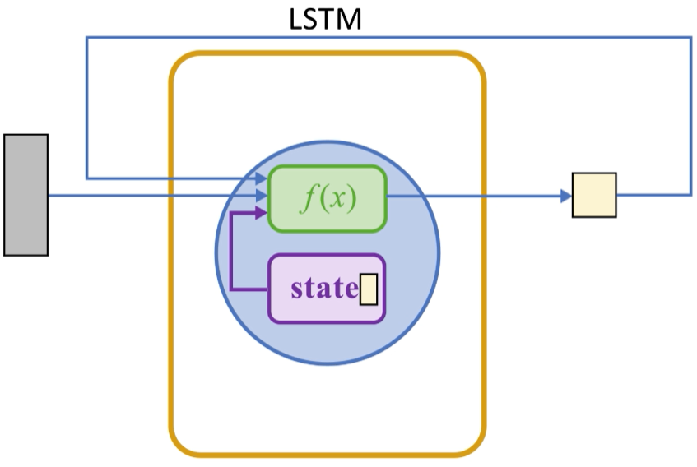
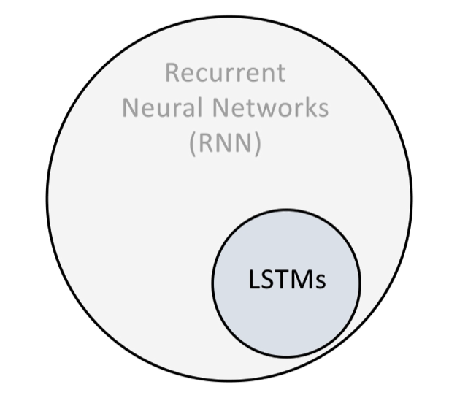
Long Short-Term Memory Networks
LSTMs are a special type of RNNs, capable of learning long-term dependencies
In LSTMs each node uses an internal state as a working memory space:
Information can be stored and retrieved over many time steps
The input value, previous output, and the internal state are all used in the node’s calculation:
The result is used to provide output value and to update the state
Notes:
Introduction to Long Short-Term Memory Networks
LSTMs excel in learning, processing, and classifying sequential data.

Slide 8
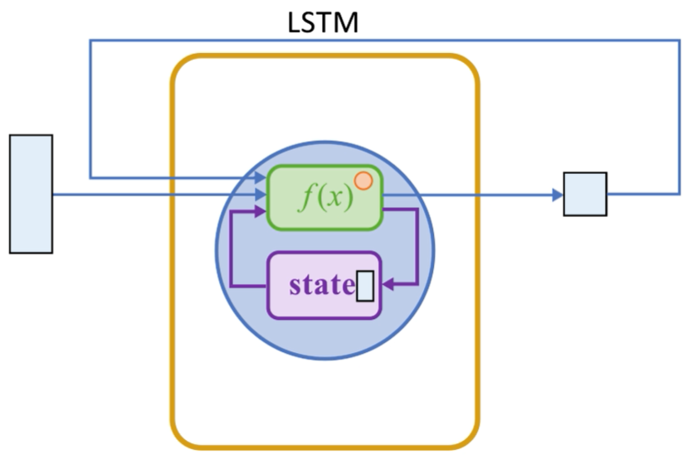
Internal view of LSTM
LSTM nodes have parameters that determine how the inputs are used in the calculation
LSTMs also have parameters, the gates, that control the flow of information within the node
These gate parameters are weights and biases which means the behavior depends on the inputs
Node parameters
Notes:
This slide shows an internal view of LSTM

Slide 9
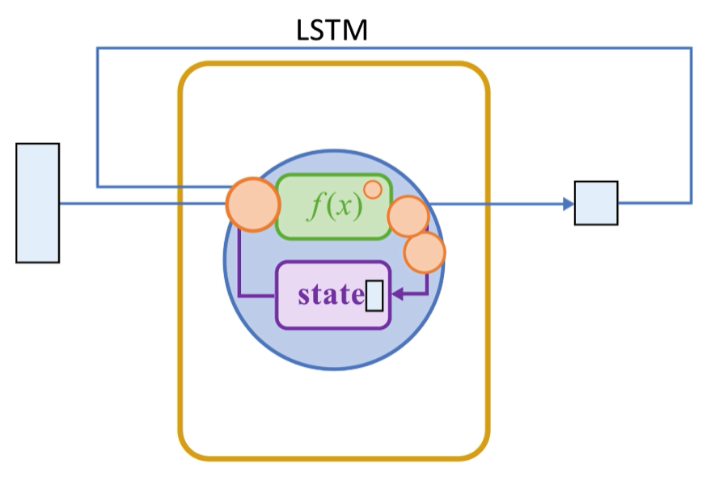

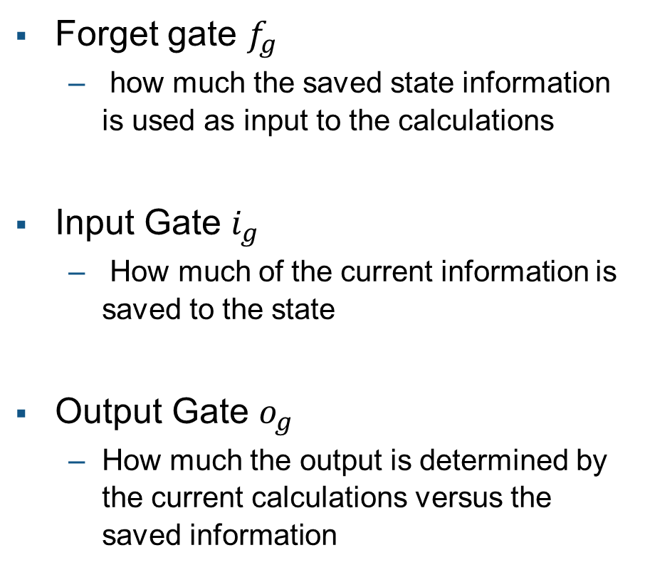


LSTM gates
Forget gate $f_{g}$
how much the saved state information is used as input to the calculations
Input Gate $i_{g}$
How much of the current information is saved to the state
Output Gate $o_{g}$
How much the output is determined by the current calculations versus the saved information
Node parameters
$$f_{g}$$
$$o_{g}$$
$$i_{g}$$
Notes:
This slide shows details about LSTM gates.

Slide 10
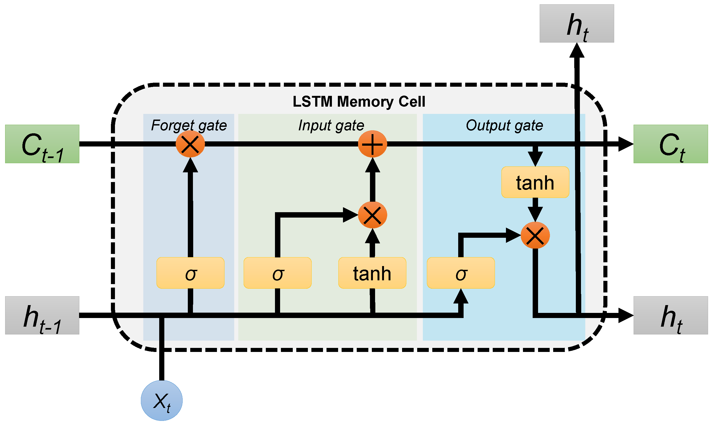
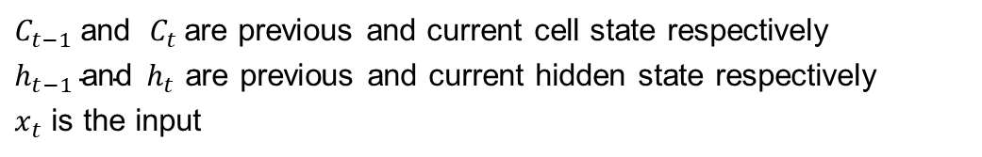
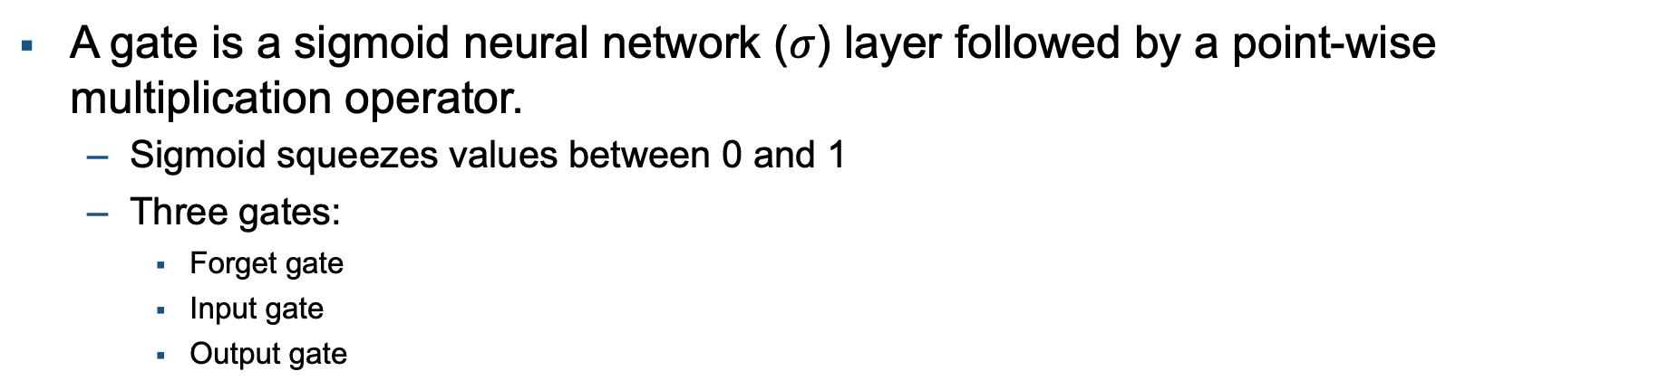

LSTM cell Architecture
A gate is a sigmoid neural network ($σ$) layer followed by a point-wise multiplication operator.
Sigmoid squeezes values between 0 and 1
Three gates:
Forget gate
Input gate
Output gate
o_{t}
f_{t}
i_{t}
$$\tilde{C}$$
$C_{t−1}$and ${ C}_{t}$are previous and current cell state respectively
$h_{t−1} \text{and} h_{t}$ are previous and current hidden state respectively
$x_{t}$ is the input
Notes:
The architecture for an LSTM block is shown in this slide. An LSTM block typically has a memory cell, input gate, output gate, and forget gate in addition to the hidden state in traditional RNNs.
The weights and biases to the input gate control the extent to which a new value flows into the cell.
Similarly, the weights and biases to the forget gate and output gate control the extent to which a value remains in the cell and the extent to which the value in the cell is used to compute the output activation of the LSTM block, respectively.

Slide 11
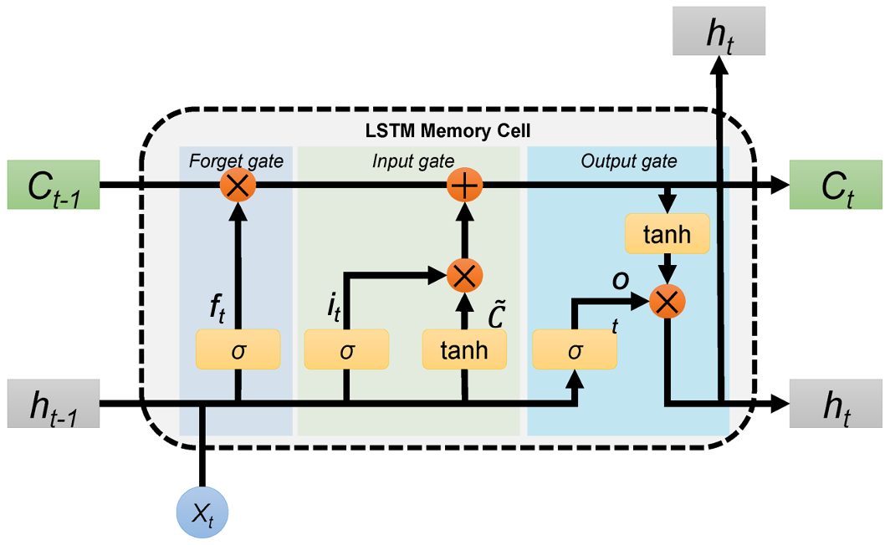

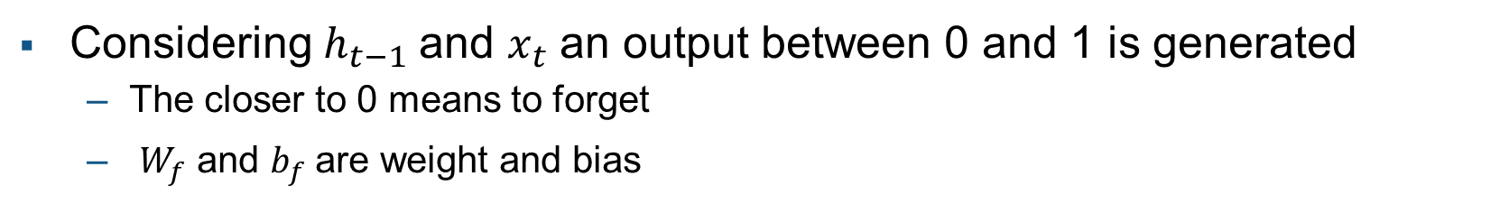
Forget Gate
It controls what information to discard from the memory
How much of the past should be remembered
Considering $h_{t−1}$and $x_{t}$ an output between 0 and 1 is generated
The closer to 0 means to forget
$W_{f}$ and $b_{f}$ are weight and bias
$$f_{t}=σ(W_{f}∙\left[h_{t−1},x_{t}\right]+b_{f})$$
Notes:
Details about forget gate

Slide 12

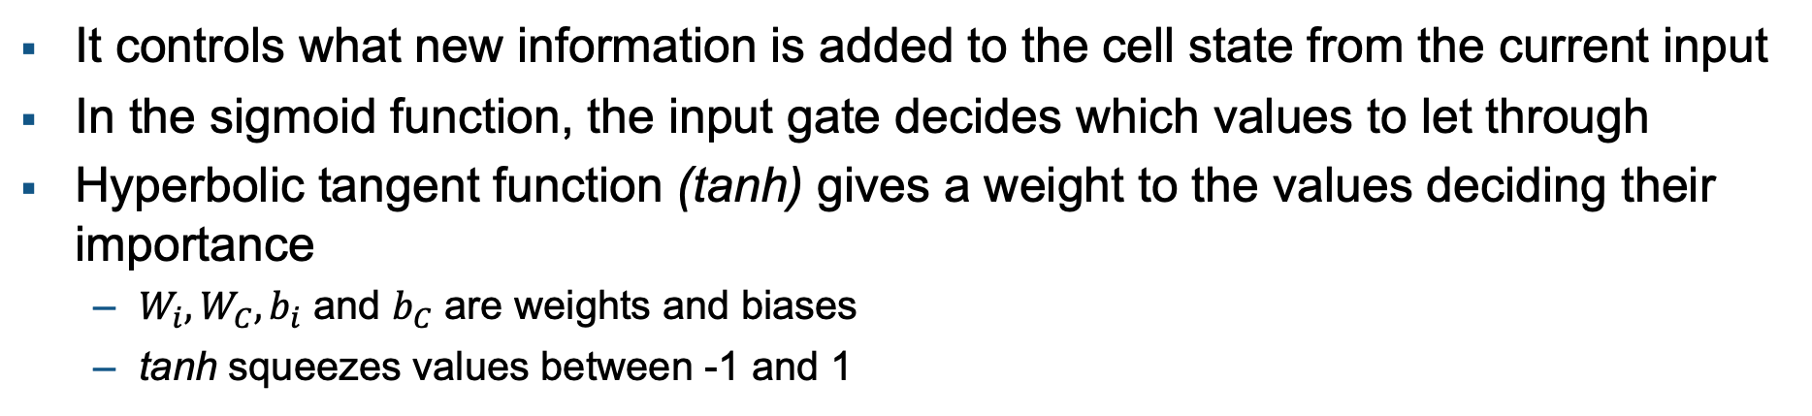

Input Gate
It controls what new information is added to the cell state from the current input
In the sigmoid function, the input gate decides which values to let through
Hyperbolic tangent function (tanh) gives a weight to the values deciding their importance
$W_{i}, W_{C}, b_{i}$ and $b_{C}$ are weights and biases
tanh squeezes values between -1 and 1
$$i_{t}=σ(W_{i}∙\left[h_{t−1},x_{t}\right]+b_{i})$$
$${\tilde{C}}_{t}=tanh(W_{C}∙\left[h_{t−1},x_{t}\right]+b_{C})$$
Notes:
Details about input gate

Slide 13

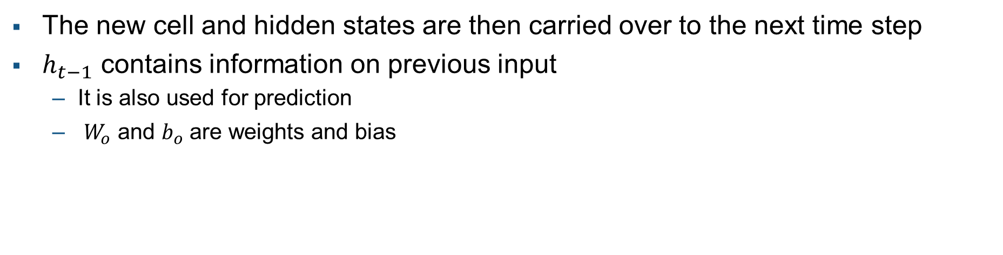

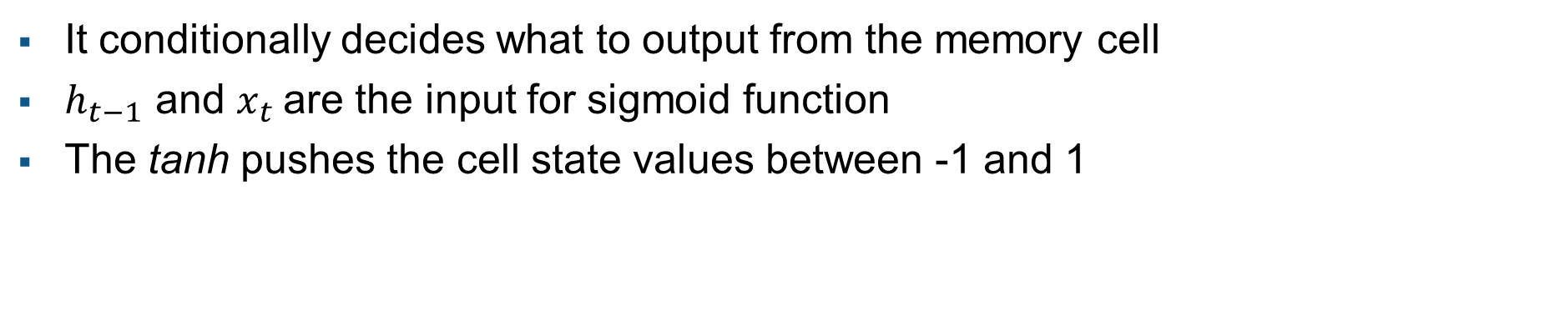
Output Gate
It conditionally decides what to output from the memory cell
$h_{t−1}$ and $x_{t}$are the input for sigmoid function
The tanh pushes the cell state values between -1 and 1
The new cell and hidden states are then carried over to the next time step
$h_{t−1}$ contains information on previous input
It is also used for prediction
$W_{o}$ and $b_{o}$ are weights and bias
$$o_{t}=σ(W_{o}∙\left[h_{t−1},x_{t}\right]+b_{o})$$
o_{t}
$$h_{t}=o_{t}∗tanh⁡(C_{t})$$
Notes:
Details about output gate

